Slide 1
Project: Virtual Queue 2.0 Student: Kenneth Kon Michael Lazo Mentor: Bernard Parenteau
Sprint 3 Presentation
CIS 4911 Senior Project
School of Computing and Information Sciences
Florida International University
<03/23/2015>

Slide 2
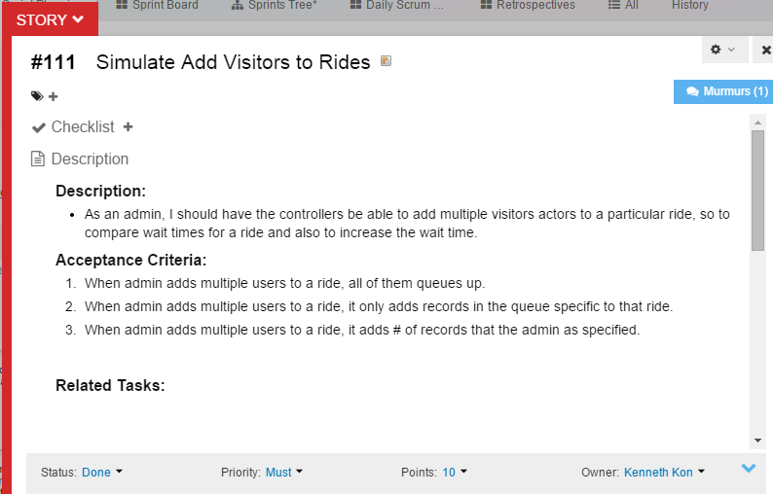
User Story
Sprint Velocity:
30 per Sprint

Slide 3
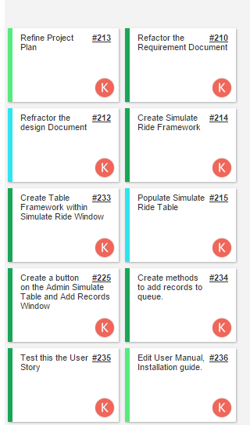
User Story: Tasks

Slide 4

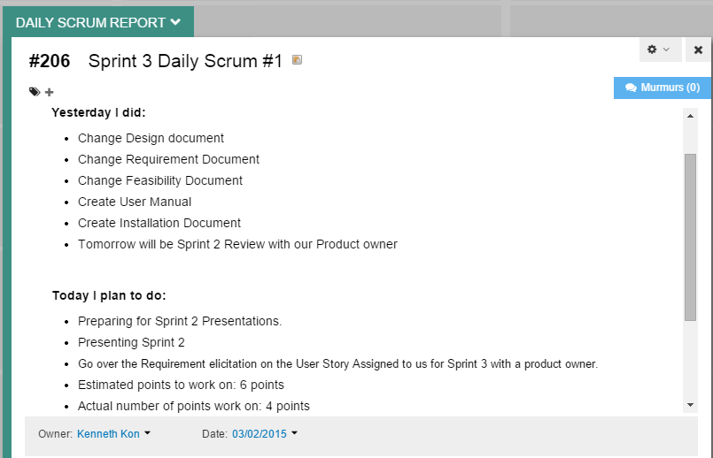
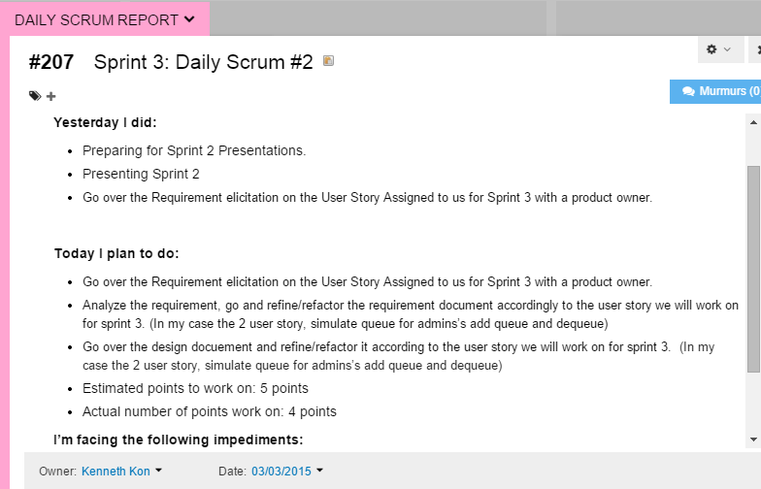
Daily Scrums 1 & 2
Worked on:
Points Estimated to Work on: 6
Points Actually Worked on: 4
Points Estimated to Work on: 5
Points Actually Worked on: 4

Slide 5
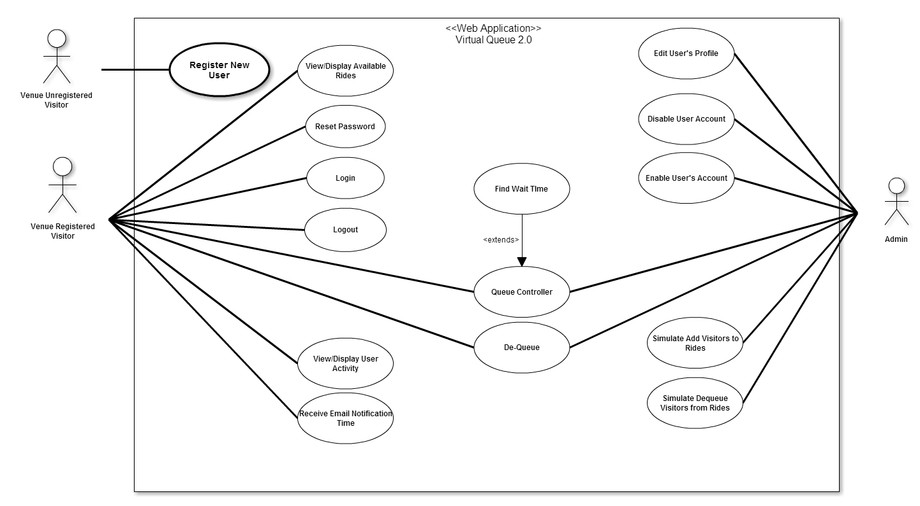
Use Case Diagram:
Edited in Requirement Document

Slide 6
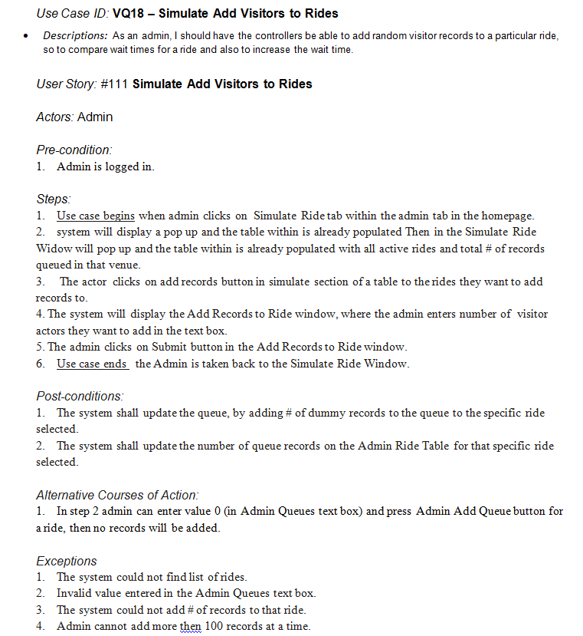
Use Case:
Added In Requirement Document

Slide 7
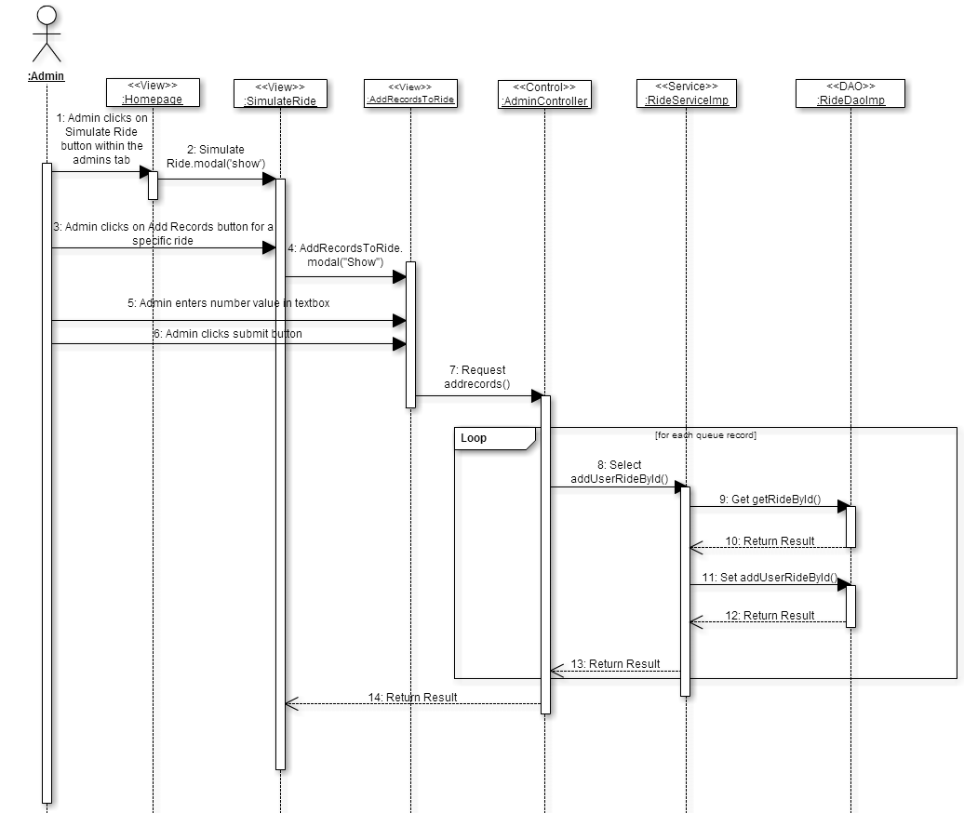
Sequence Diagram: Added In Requirement Document

Slide 8
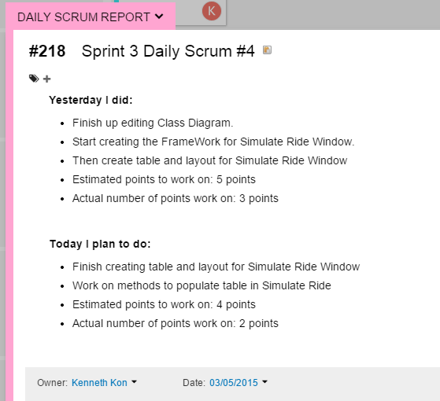
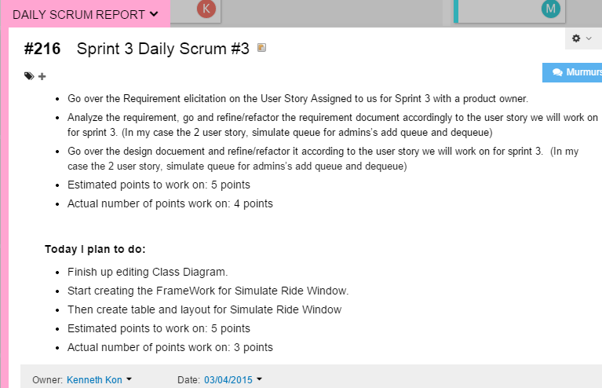
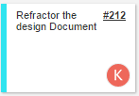
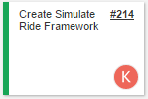


Daily Scrums 3 & 4
Points Estimated to Work on: 5
Points Actually Done: 3
Points Estimated to Work on: 4
Points Actually Done: 2

Slide 9
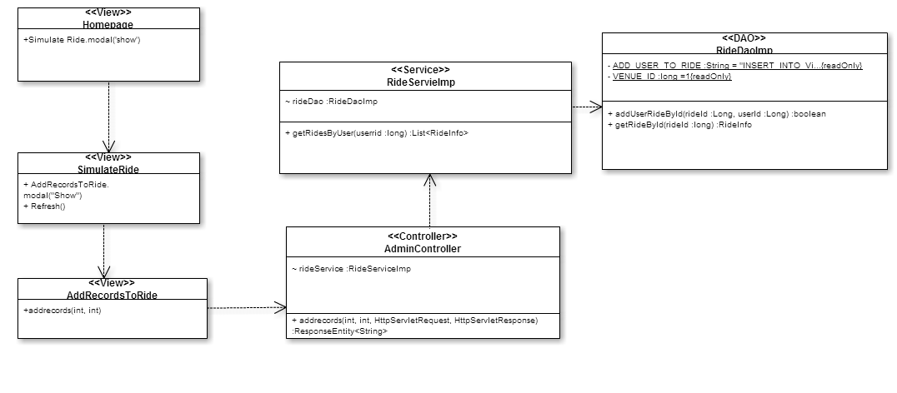
Class Diagram: Added in Design Document

Slide 10
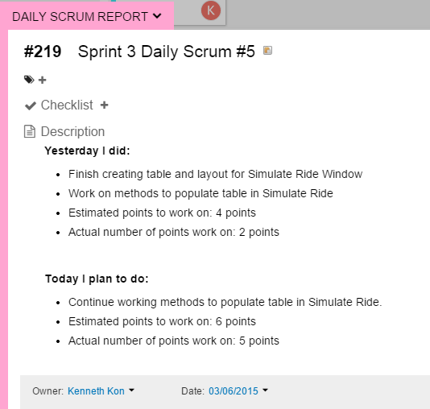
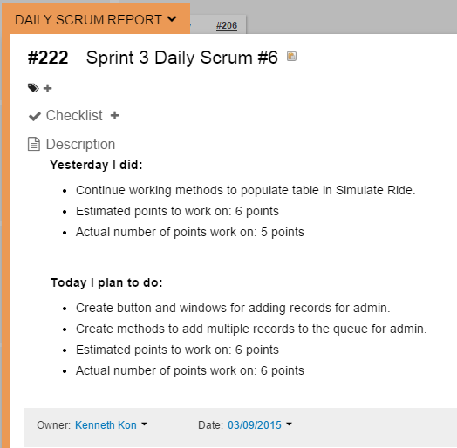
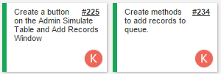
Daily Scrums 5 & 6
Points Estimated to Work on: 6
Points Actually Done: 5
Points Estimated to Work on: 4
Points Actually Done: 3

Slide 11
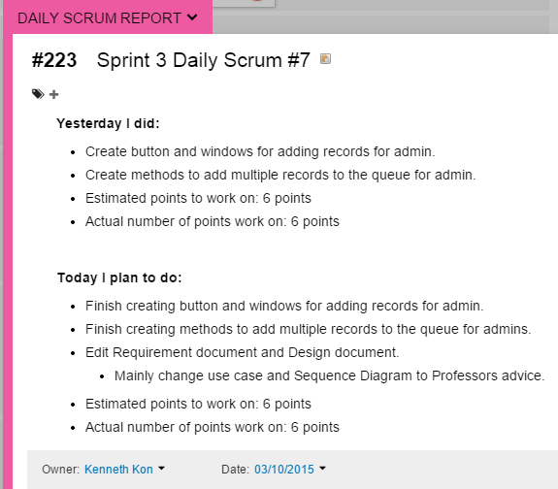

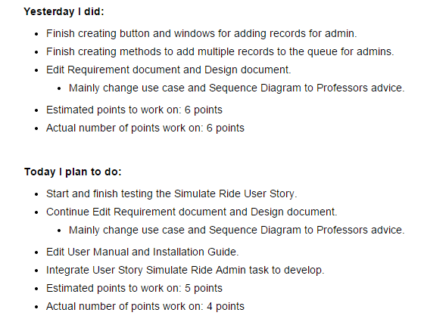
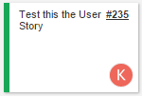
Daily Scrums 7 & 8
Points Estimated to Work on: 6
Points Actually Done: 6
Points Estimated to Work on: 5
Points Actually Done: 4

Slide 12
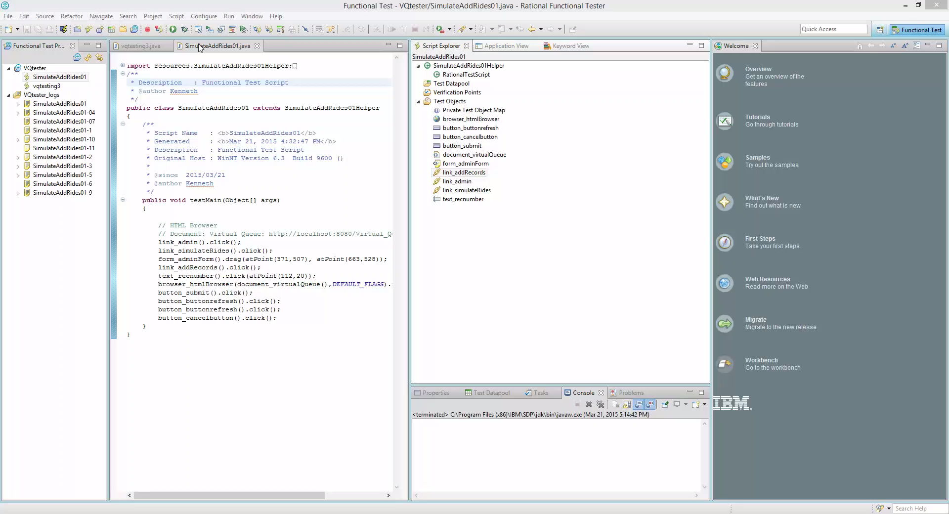
Demo

Slide 13
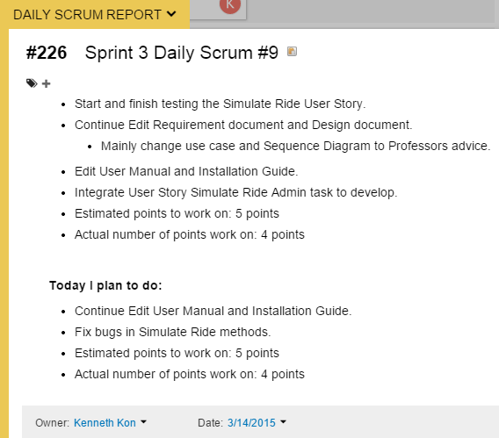
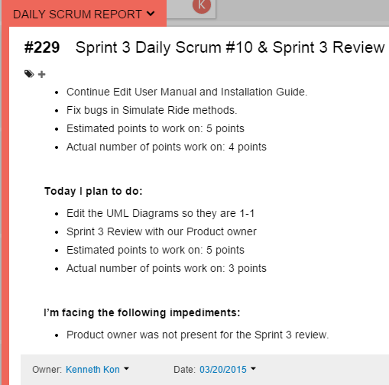
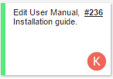
Daily Scrums 9 & 10
Points Estimated to Work on: 5
Points Actually Done: 4
Points Estimated to Work on: 5
Points Actually Done: 3
Total Points Estimated to Work on: 51 Points
Total Points Actually Done: 38 Points

Slide 14
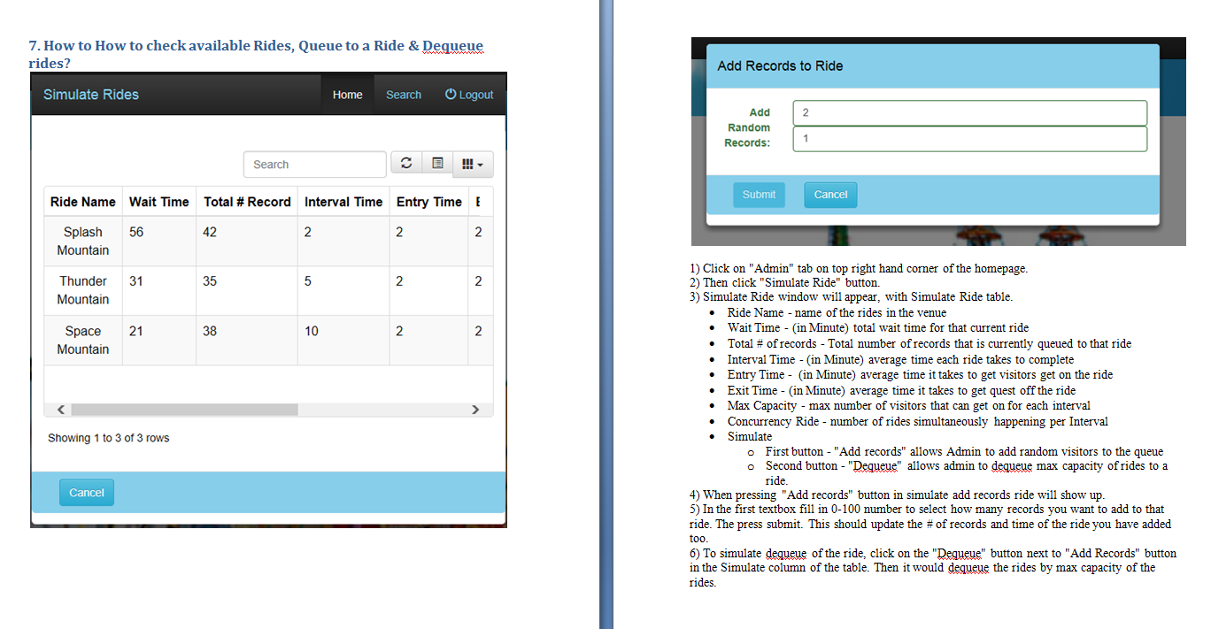
Add Simulate Ride in User Guide
No edits made to Installation Manual

Slide 15
Sprint 3 Report
Simulate Add Visitors to Rides: User Story (Accepted)

Slide 16
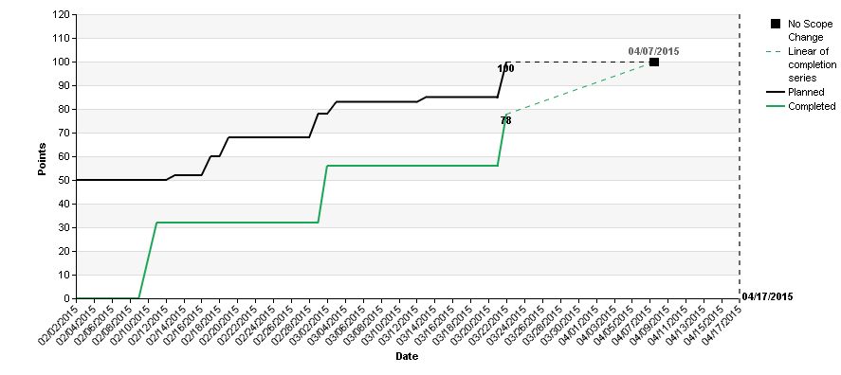
Burn-up charts

Slide 17
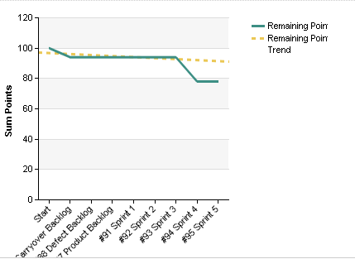
Burn Down charts

Slide 18
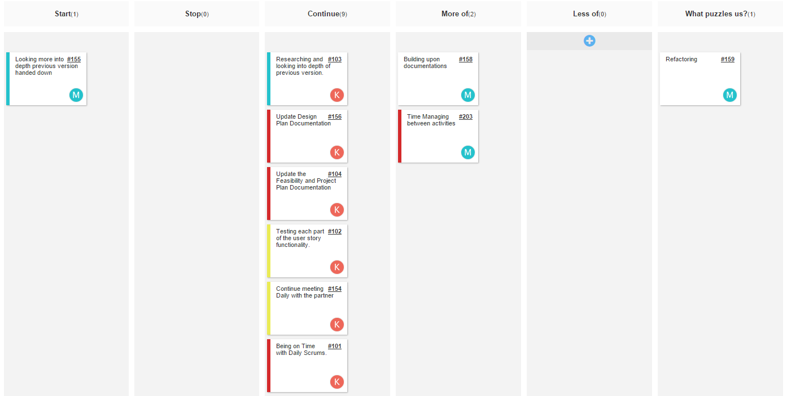
Retrospectives

Slide 19
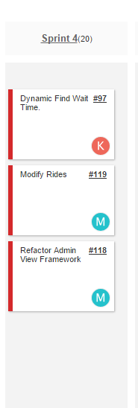
Sprint 4 Planning
Dynamic: Find Wait Time

